Slide 1

Smart ChatBot

Slide 2

Ajay Kumar Garg Engineering College-MCA, Ghaziabad
Under Guidance of Submitted By
<Dheeraj Kumar Singh> <Rishabh Maheshwari><2000270140044>
<Shivam Singh><2000270140049>
<Vicky Kumar><2000270140060>

Slide 3
Chatbot
Smart Chatbot Software is a new technology that uses Machine Learning and Artificial Intelligence as it's base. It is a smart tool to be implemented in Customer Service for an Organization that takes input in form of text and can smartly recognize the query of a customer and provide a personal unique solution to their problems. It is also capable enough to recognize the frequently asked questions by the customers and store and display them on top of the screen for better and faster customer interaction and bot response providing unique solutions every time to maintain customer satisfaction as equivalent to a Human customer service interaction. The chatbot will allow users to feel confident and comfortable when using this service regardless of the user’s computer literacy due to the natural language used in messages. It also provides a very accessible and efficient service as all interactions will take place within the one chat conversation negating the need for the user to navigate through a site.

Slide 4
Introduction: The computer is fast emerging as a daily need in walks of life. The Knowledge of computers and programming languages has become a basic skill needs to service in today’s information-based society. Every business institution and the corporate section, make use of computers for making their operation efficient and effective.
Purpose: This document will provide all of the requirements for the project Smart Chatbot. It will serve as a reference for developers and customers during the development of the final version of the system.
Software Tools Specification:
Database:
MySQL:
MySQL is a relational database management system based on SQL(Structured Query Language).The application is used for a wide range of purposes, including data warehousing, e-commerce, and logging applications. It can be used to store anything from a single record of information.
MySQL is free and open-source software under the terms of the GNU General Public License, and is also available under a variety of proprietary licenses.

Slide 5
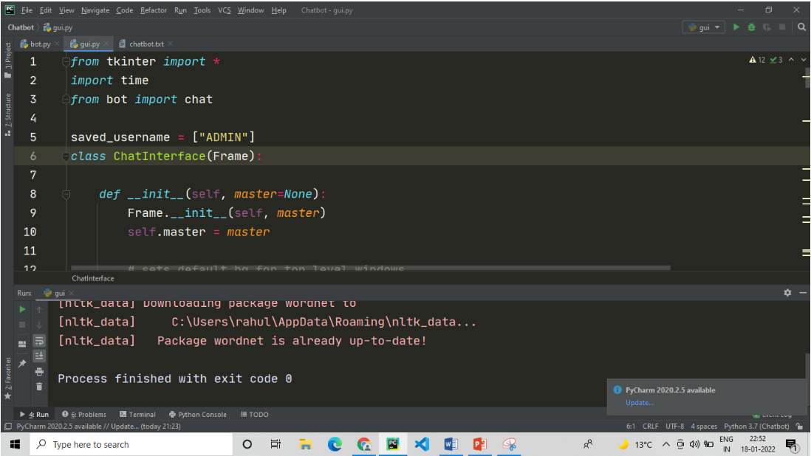
Front End:
Tkinter
Tkinter is the standard GUI library for Python. Python when combined with Tkinter provides a fast and easy way to create GUI applications. Tkinter provides a powerful object-oriented interface to the Tk GUI toolkit.

Slide 6
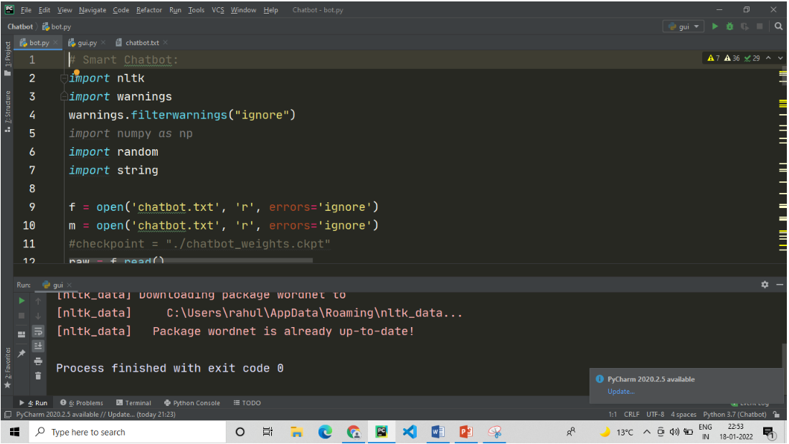
Back End:
Python:
Python is an interpreted, object-oriented, high-level programming language with dynamic semantics. Its high-level built in data structures, combined with dynamic typing and dynamic binding, make it very attractive for Rapid Application Development, as well as for use as a scripting or glue language to connect existing components together

Slide 7
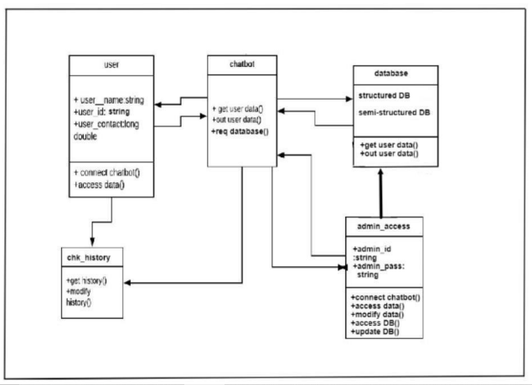
Class Diagram

Slide 8
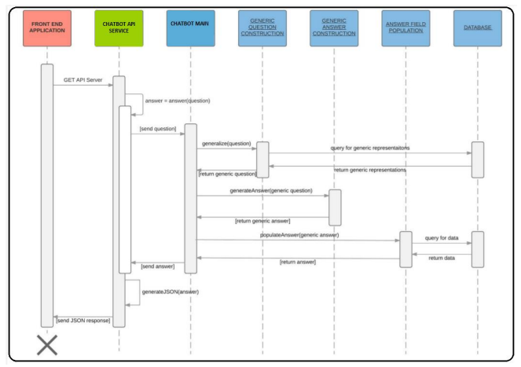
Sequence Diagram

Slide 9
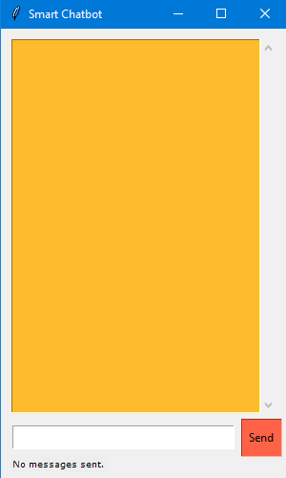
ChatBot Window

Slide 10
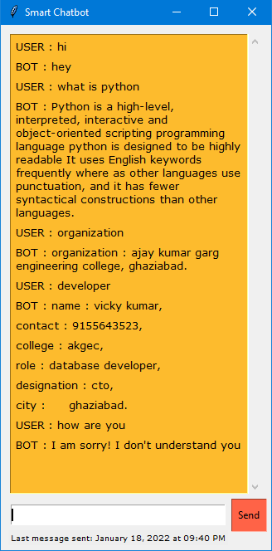
Conversation with chatbot

Slide 11
Conclusion:
While developing the system a conscious effort has been made to create and develop this Smart Chatbot , making use of available tools, techniques and resources – that would generate a proper system for smooth working the Smart Chatbot API and it’s proper maintenance and database upgrades. The system will be acceptable to any user query and will uniquely provide a satisfactory solution his/her needs. For reliability, efficiency and cost cutting on customer services , the organisation shall adapt to this Smart Chatbot developed system.

